Slide 1
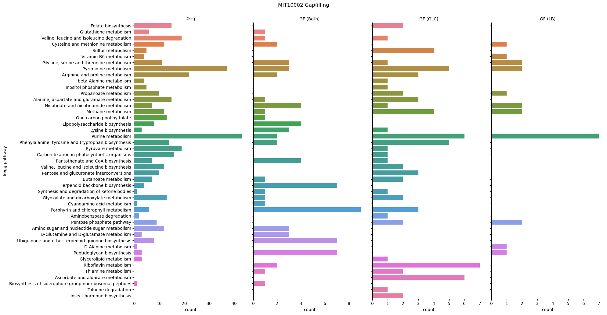
MIT1002
KEGG categories where reactions were added by gapfill
Overlap between both gapfills
Reactions unique for a specific gapfill

Slide 2
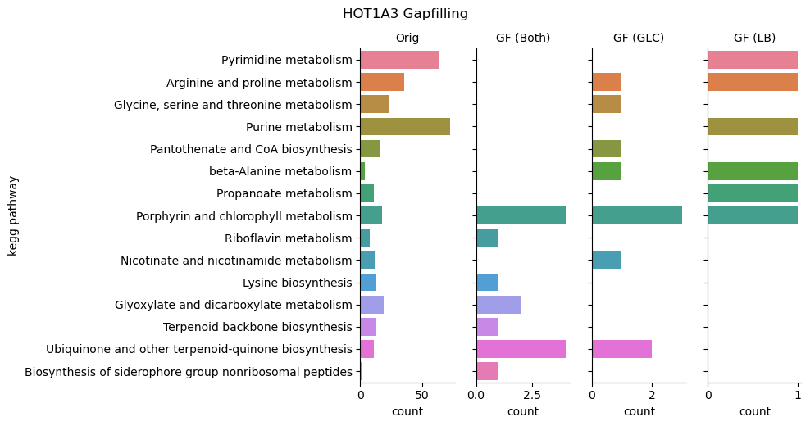
HOT1A3
KEGG categories where reactions were added by gapfill
Overlap between both gapfills
Reactions unique for a specific gapfill

